Slide 1


Relationship between spinal lesions and activity of axial spondyloarthritis and degenerative spinal lesions:
10-year follow-up of the DESIR cohort
18 septembre 2024

Slide 2
Introduction
Radiographs and MRI : assess structural and inflammatory lesions in axial spondyloarthritis (axSpA)
Degenerative lesions (DLs): frequent in this population
Potential relationship between axSpA lesions and DLs not known

Slide 3
Objectives
Investigate the relationship between spinal lesions of axSpA and DLs on MRI and radiographs over 10Y

Slide 4
Methods
Patients diagnosed with axSpA in the DESIR cohort with 2 time points reading
Cervical/lumbar spine radiographs (vertebrae 1 to 6 and 18 to 23 = 12 vertebrae per patient and per time point): baseline, 5Y and 10Y
Assessment for DLs (osteophytes) and axSpA lesions (syndesmophytes) by 2 groups of three central readers
Use of consensus among readers to define lesions: agreement between ≥2 out of 3 readers

Slide 5
Methods
Relationship between syndesmophytes and osteophytes on radiographs:
Risk of confusion between lesions (assessment by 2 different groups of readers)
Exclusion vertebrae with both lesions and in which a syndesmophyte led to an osteophyte or vice versa
Analysis of lesions on adjacent vertebrae (upper or lower vertebrae)
Concurrent risk of syndesmophytes and osteophytes on the same vertebra:
Outcome = dummy variable (syndesmophyte, osteophyte, no syndesmophyte/osteophyte on adjacent vertebrae)
Independent variable = syndesmophyte at one vertebral level
Time-lagged autoregressive GEE model
Models adjusted for: age, sex, HLA-B27 status, BMI, smoking, job type, biologic treatment during follow-up

Slide 6
Variables used
Osteo_synm_tot_corr_upp_low_2 = outcome = presence of a syndesmophyte or osteophyte or none on the adjacent vertebra ( upper or lower).
0 : no osteophyte nor syndesmophyte in adjacente vertebra
1: osteophyte in adjacente vertebra
2: syndesmophyte in adjacente vertebra
synm_tot_lag = variable of interest = the lag of synm_tot corresponding to the presence of a syndesmophyte at a vertebral level at the previous time point
Osteo_synm_tot_corr_upp_low_2_lag = the lag of the outcome Osteo_synm_tot_corr_upp_low_2 corresponding to presence of a syndesmophyte or osteophyte or none on the adjacent vertebra at the previous time point
t_new = time variable (0 or 60 or 120 months)
id_vertebra = corresponds to the concatenation of the patient identifier (id) and the vertebra number
sexe = sex
age_m0 = age at baseline
bmi = body mass index
hla = HLA-B27+
tabac_10y = tobacco use (ever or never)
profession = job type
bdmard_lag = the lag of bdmard corresponding to the exposure to biologic treatments at the previous time point (time varying variable)

Slide 7
Syndesmophytes at previous time point and osteophytes/syndesmophytes on adjacent vertebrae: descriptive analysis
Syndesmophyte/osteophyte on adjacent vertebra: | None Osteo_synm_tot_corr_upp_low_2=0 | Osteophyte Osteo_synm_tot_corr_upp_low_2=1 | Syndesmophyte Osteo_synm_tot_corr_upp_low_2=2
Syndesmophyte at one vertebral level at previous type point:
No synm_tot_lag=0 | 5772 (88%) | 658 (10%) | 152 (2%)
Yes synm_tot_lag=1 | 38 (41%) | 5 (5%) | 49 (53%)

Slide 8
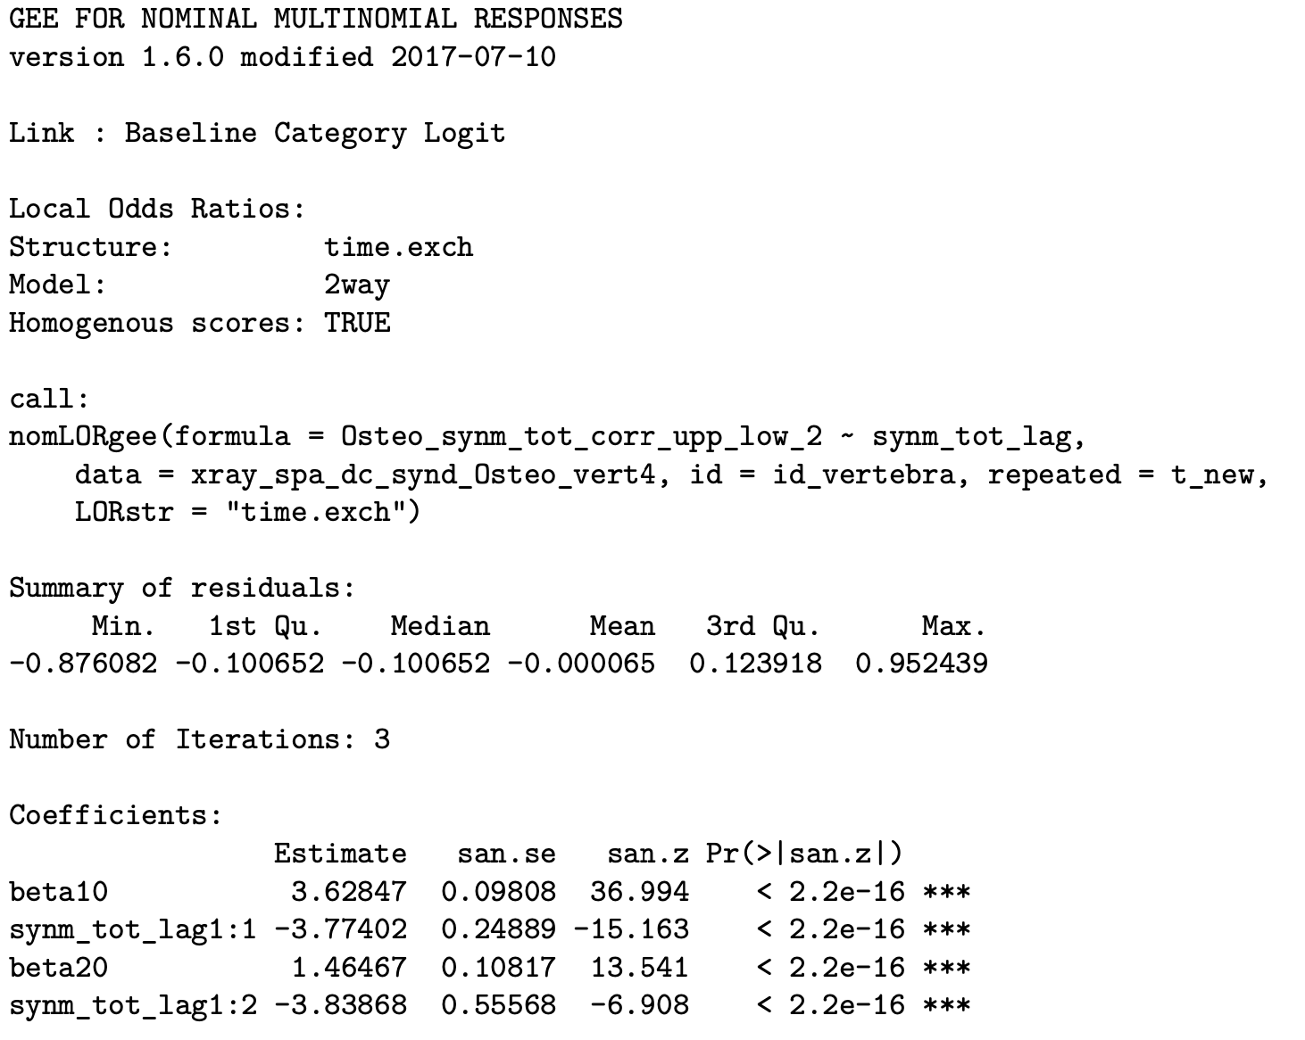
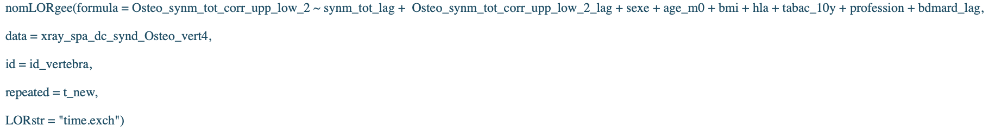
Results with multgee package on R: univariate analysis
For outcome: Osteophyte (Osteo_synm_tot_corr_upp_low_2=1) <=
For outcome: Syndesmophyte (Osteo_synm_tot_corr_upp_low_2=2) <=

Slide 9
Results with multgee package on R: multivariate analysis

Slide 10
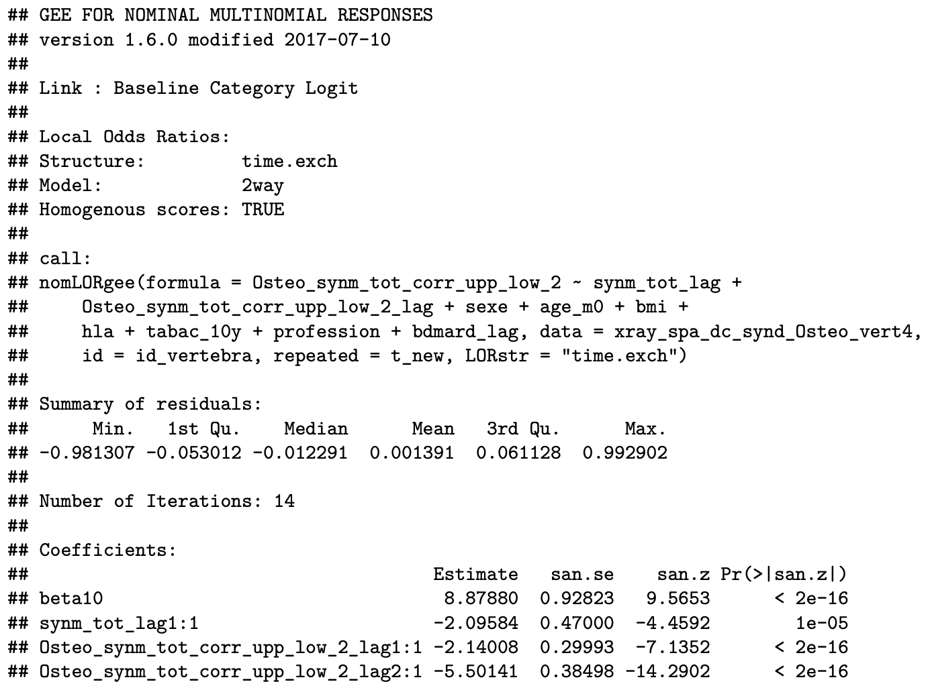
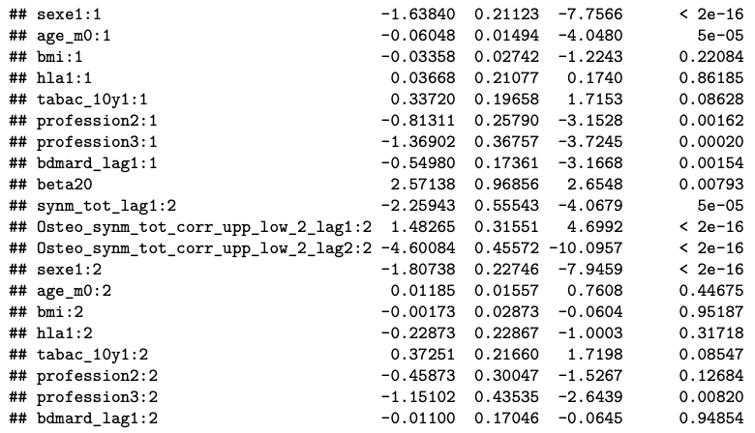
For outcome: Osteophyte (Osteo_synm_tot_corr_upp_low_2=1) <=
For outcome: Syndesmophyte (Osteo_synm_tot_corr_upp_low_2=2) <=

Slide 11
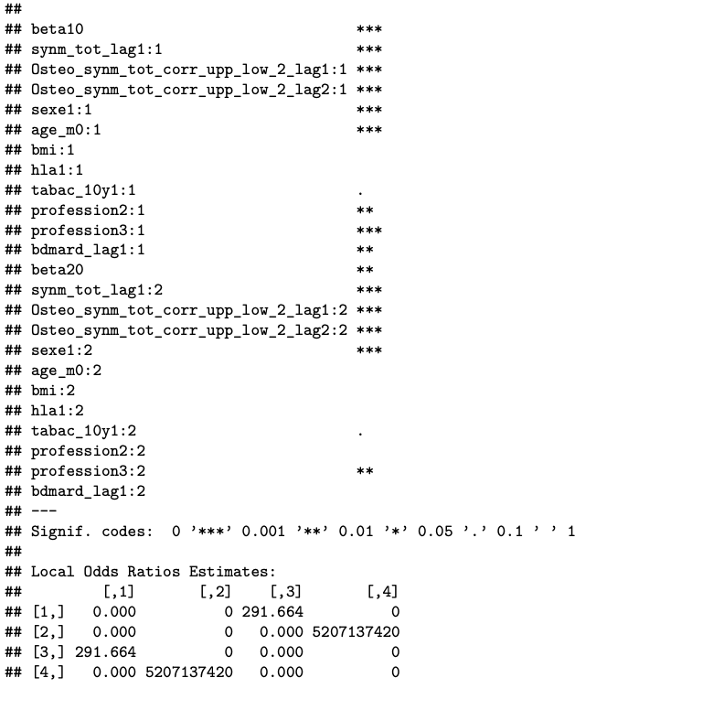


Slide 12
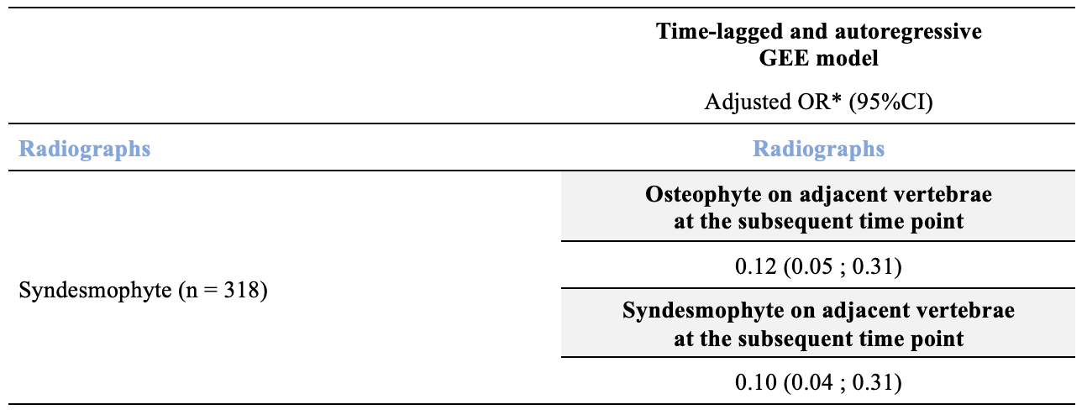
Relationship between syndesmophytes and osteophytes or syndesmophytes on adjacent vertebrae on radiographs: R

Slide 13
Results with multgee package on R: multivariate analysis
proc gee data=data;
class Osteo_synm_tot_corr_upp_low_2(REF='0’) synm_tot_lag(REF = '0') Osteo_synm_tot_corr_upp_low_2_lag id_vertebra t_new hla tabac_10y profession bdmard_lag ;
model Osteo_synm_tot_corr_upp_low_2= synm_tot_lag Osteo_synm_tot_corr_upp_low_2_lag sexe age_m0 bmi hla tabac_10y profession bdmard_lag / dist=multinomial link=glogit;
repeated subject=id_vertebra / within=t_new;
run;

Slide 14
Standard 95% Confidence
Parameter Y Estimate Error Limits Z Pr > |Z|
Intercept 1 -6.4252 0.4111 -7.2309 -5.6195 -15.63 <.0001
Intercept 2 -7.7129 0.8798 -9.4372 -5.9886 -8.77 <.0001
XLAG 1 1 0.0527 0.7242 -1.3668 1.4722 0.07 0.9420
XLAG 1 2 1.9339 0.5317 0.8918 2.9761 3.64 0.0003
XLAG 0 1 0.0000 0.0000 0.0000 0.0000 . .
XLAG 0 2 0.0000 0.0000 0.0000 0.0000 . .
YLAG 2 1 0.4336 1.0536 -1.6315 2.4986 0.41 0.6807
YLAG 2 2 6.1210 0.4083 5.3208 6.9213 14.99 <.0001
YLAG 1 1 4.8973 0.2037 4.4981 5.2965 24.04 <.0001
YLAG 1 2 1.4434 0.6391 0.1907 2.6961 2.26 0.0239
YLAG 0 1 0.0000 0.0000 0.0000 0.0000 . .
YLAG 0 2 0.0000 0.0000 0.0000 0.0000 . .
sexe 1 -0.1124 0.1225 -0.3526 0.1277 -0.92 0.3588
sexe 2 1.6000 0.2259 1.1573 2.0426 7.08 <.0001
age_m0 1 0.0697 0.0067 0.0566 0.0828 10.45 <.0001
age_m0 2 0.0570 0.0148 0.0280 0.0861 3.85 0.0001
bmi 1 0.0341 0.0139 0.0068 0.0613 2.45 0.0143
bmi 2 0.0394 0.0298 -0.0190 0.0979 1.32 0.1861
hla 0 1 0.2741 0.1188 0.0414 0.5069 2.31 0.0210
hla 0 2 0.0097 0.2218 -0.4250 0.4444 0.04 0.9651
hla 1 1 0.0000 0.0000 0.0000 0.0000 . .
hla 1 2 0.0000 0.0000 0.0000 0.0000 . .
tabac_10y 0 1 -0.0895 0.1157 -0.3163 0.1373 -0.77 0.4394
tabac_10y 0 2 0.3488 0.2088 -0.0604 0.7581 1.67 0.0948
tabac_10y 1 1 0.0000 0.0000 0.0000 0.0000 . .
tabac_10y 1 2 0.0000 0.0000 0.0000 0.0000 . .
profession 1 1 -0.2737 0.3094 -0.8801 0.3327 -0.88 0.3763
profession 1 2 -1.3910 0.4136 -2.2016 -0.5805 -3.36 0.0008
profession 2 1 0.1543 0.2574 -0.3502 0.6588 0.60 0.5489
profession 2 2 -0.8372 0.3615 -1.5457 -0.1287 -2.32 0.0206
profession 3 1 0.0000 0.0000 0.0000 0.0000 . .
profession 3 2 0.0000 0.0000 0.0000 0.0000 . .
bdmard_lag 0 1 -0.0101 0.1364 -0.2774 0.2573 -0.07 0.9411
bdmard_lag 0 2 0.0414 0.3087 -0.5637 0.6465 0.13 0.8934
bdmard_lag 1 1 0.0000 0.0000 0.0000 0.0000 . .
bdmard_lag 1 2 0.0000 0.0000 0.0000 0.0000 . .
For outcome: Osteophyte (Osteo_synm_tot_corr_upp_low_2=1) <=
For outcome: Syndesmophyte (Osteo_synm_tot_corr_upp_low_2=2) <=
Here :
the outcome is called Y
the independent variable is called X

Slide 15
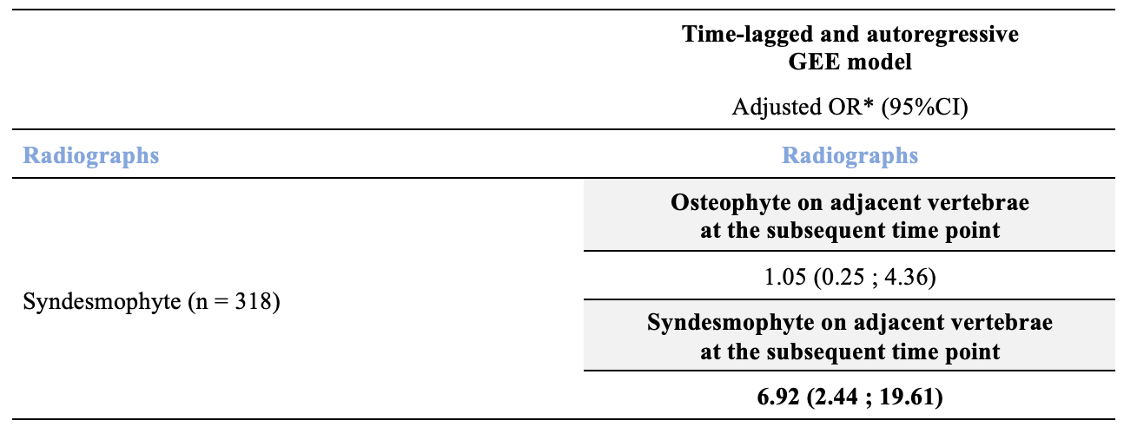
Relationship between syndesmophytes and osteophytes or syndesmophytes on adjacent vertebrae on radiographs: SAS

